Slide 1
HemaCore Labs
Thrombodynamics-4D
Assay description

Slide 2
About Thrombodynamics-4D
2
Thrombodynamics-4D – next generation of thrombodynamics assay, that additionally allows monitoring spatial dynamics of thrombin generation in parallel with spatial fibrin clot growth registration.
Thrombodynamics-4D is intended for evaluation of effects of new direct oral anticoagulants (direct thrombin and fXa inhibitors) and procoagulant platelets function (when working on PRP)
Thrombodynamics-4D =
Thrombodynamics +
Thrombin Generation Test

Slide 3
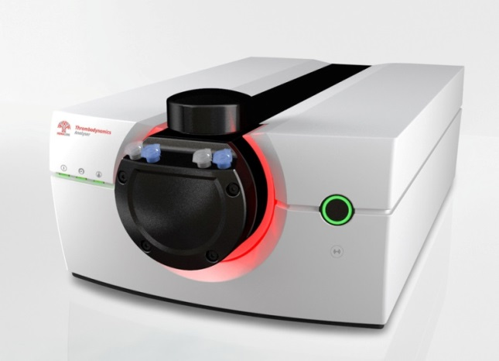
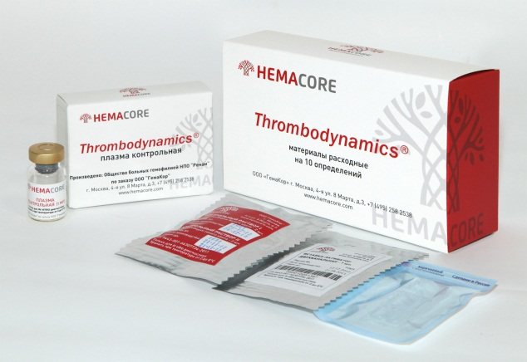
Device and kits for TD-4D analysis
3
Thrombodynamics-4D Analyser
Basic TD measurements;
TD4D measurements;
TD and TD4D parallel measurements in separate cuvette channels;
Reagent Kits
TDX kit – for basic TD measurements in PFP;
PLS kit – for TD and TD4D measurements in PFP with phospholipids (evaluation of NOAC effects);
ADP kit – for TD and TD4D measurements in PRP (evaluation of antiplatelet drugs effects) – soon available

Slide 4
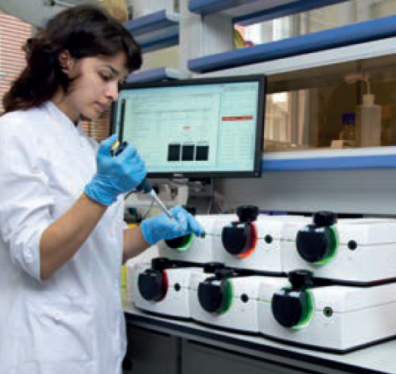
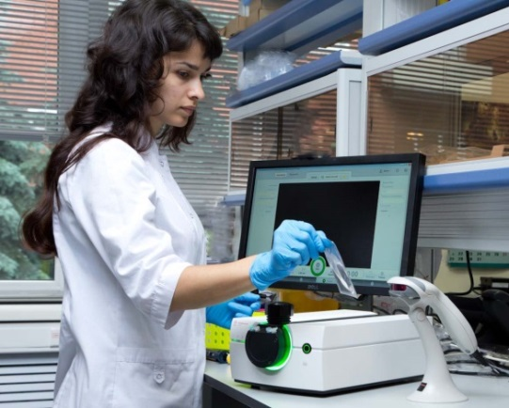
Thrombodynamics Analyser System
4
Productivity of one module – 4 tests per hour
Up to 6 modules may be combined in one system
Volume of plasma sample – 120 µl
Design and ergonomics – WILDDESIGN, Germany with the participation of velixX, Germany

Slide 5
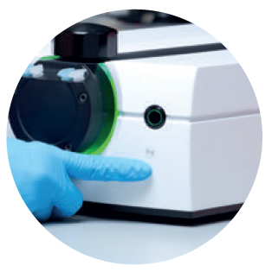
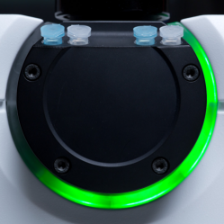
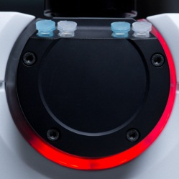
System Ergonomics
5
Elaborated ergonomics of the multi-module system: just bring the finger to the proximity sensor of the module to display its activity on the monitor
Progress bar. Light and color indication of System status and measurement process stage

Slide 6
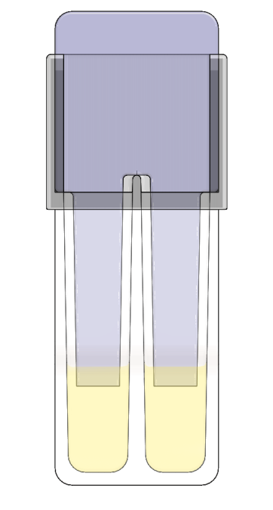
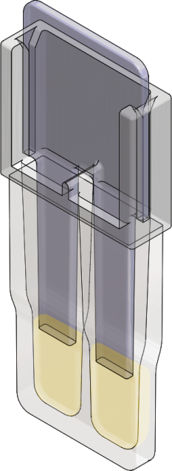
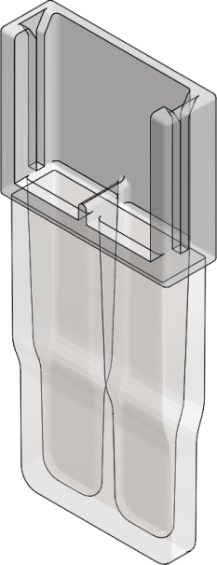
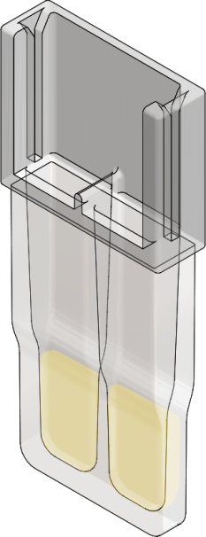
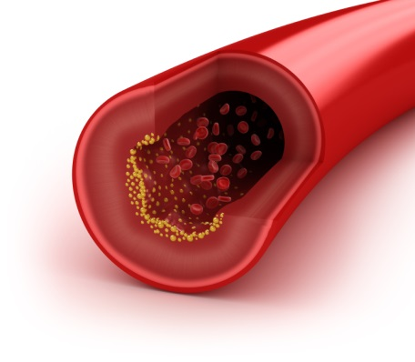
The idea behind Thrombodynamics
6
In thrombodynamics assay real coagulation conditions are reconstructed
Activating insert
Cuvette (2 channels)
Tissue factor (coagulation activator)
=
100 pmol/m²
Tissue factor
Plasma sample

Slide 7
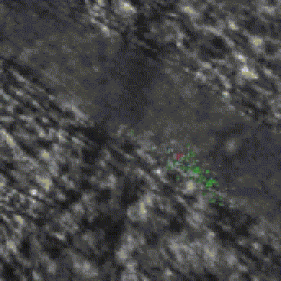
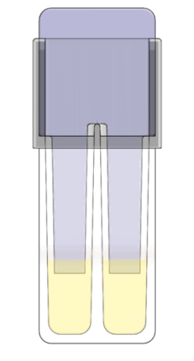
Thrombodynamics
7
In vivo. Blood vessel. Thrombus growing from damaged wall
In vitro. Thrombodynamics test. Fibrin clot growth from the immobilized activator, that mimics vessel wall damage
Tissue Factor Activator
↓ Fibrin Clot
Plasma
Activating insert
Cuvette
Tissue Factor
Tissue Factor
Fibrin
Platelets
Platelets + Fibrin
Plasma sample
Falati et al., Nature medicine, Vol 8, №10, 2002
Notes:
The main idea of Thrombodynamics assay is based on spatial separation of activation and propagation phases of coagulation. Damaged vessel wall is modeled by a surface covered with tissue factor and coagulation occurs in a thin layer of non-stirred plasma. Plasma is placed into a plastic cuvette and it is brought in contact with a plastic insert covered with TF. Tissue factor is strictly localized on the surface of the activator and there is no TF in the volume of plasma. Therefore, once coagulation is activated, clotting propagates in space without direct contact with TF. The problem of using low concentration of TF is solved by concentrating it on a surface while the work of the main part of coagulation cascade takes place without direct contact with TF and therefore depends only on the internal properties of plasma. Clot growth is visualized by light scattering from fibrin clot. Thrombodynamics analyzer records a video file shown on the right. Speed play, time of the experiment is 30 min.
Clot formation starts on the surface of the activator and propagates into the bulk of plasma.

Slide 8
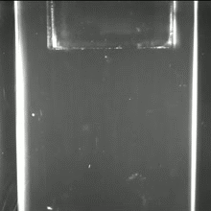
Thrombodynamics measurement
8
By means of light scattering registration one can see how fibrin clot propagates in space from the activator that mimics damaged blood vessel wall.
Red light source
Activator –
tissue factor
↓ Fibrin clot
Plasma
Cuvette
Red light source
(625 nm)

Slide 9
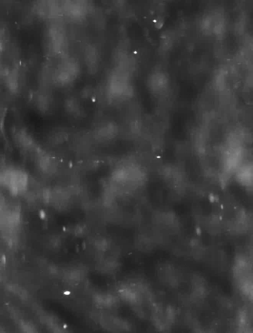
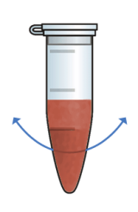
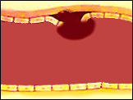
Thrombodynamics vs Routine Assays
9
Unlike routine coagulation assays (with full mixing of an activator and plasma sample) Thrombodynamics mimics in-vivo conditions of coagulation and estimates all physiological stages of fibrin clot formation.
Activation
5 min
10 min
30 min
General activation
Clotting time
Local activation
Thrombodynamics
1mm

Slide 10
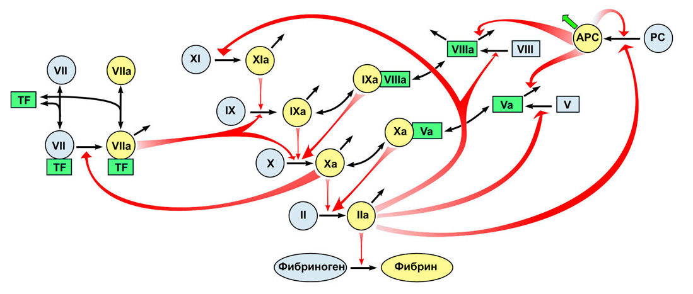
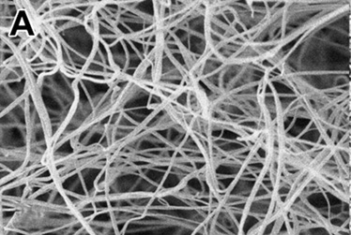
Thrombodynamics results
10
Thrombodynamics measures parameters of spatial dynamics of fibrin clot growth.
Fibrinogen
Fibrin
Major reactions of plasma coagulation system
Fibrin clot (electron microscopy)
Notes:
The growth of blood clot in the vessel is always the spreading of the area of ​​blood clotting from the vessel wall, as a result, a considerable thrombus grows. In standard hemostasis tests, thrombus growth is modeled by activation of the whole blood sample, and the clot formation time is measured. The upper row of pictures shows the formation of a fibrin clot in plasma when mixed with a small concentration of tissue factor. After some delay, the coagulation begins throughout the entire volume of the sample. But if we return to the growth of the thrombus, as shown here, the growth does not occur in the entire volume of the blood at once, but from the site of activation, increasing in size. This process is modeled in the thrombodynamics test, where activation occurs on a surface covered with a tissue factor, and we observe the growth of the fibrin clot. The growth rate of the clot reflects the work of the entire blood clotting cascade, both external and internal pathways of activation, and is the main parameter reflecting the ability of the plasma to coagulate. To say that the main parameter is the propagation speed

Slide 11
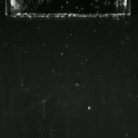
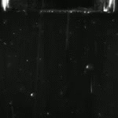
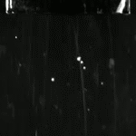
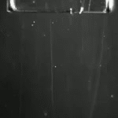
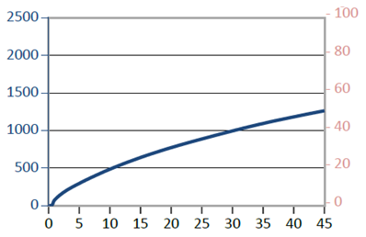
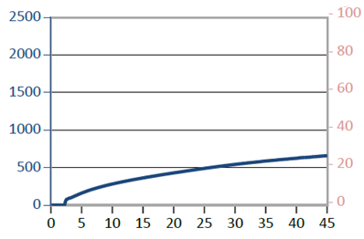
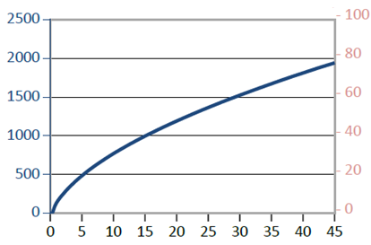
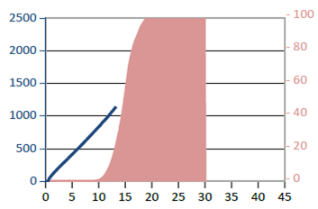
Thrombodynamics results
11
Thrombodynamics allows clear visual estimation of coagulation state and also describes it in numbers.
Video of clot growth
Normal coagulation
Hypo-coagulation
Hyper-coagulation
Severe hyper-coagulation
Clot size VS time curve

Slide 12
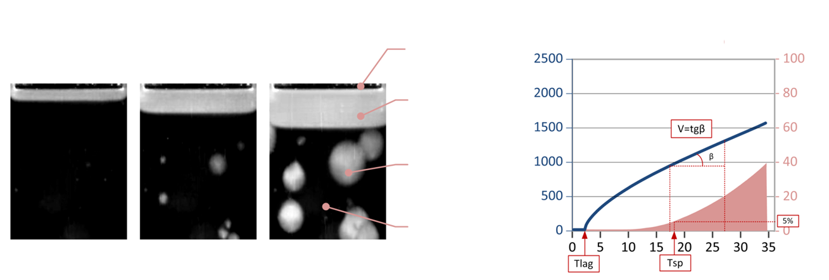
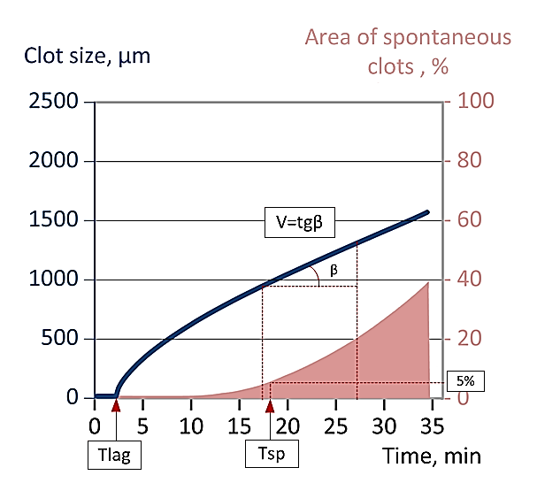
Main Thrombodynamics parameters
12
Tlag, [min] – Lag-time – time between contact of activator with plasma sample and start of clot growth
V, [µm/min] – Average rate of clot growth
Tsp, [min] – Time of spontaneous clots formation
Images
clot size, µm
activator
5 min
15 min
30 min
fibrin clot
spontaneous
clots
plasma
Time, min
Notes:
To describe the clot growth numerically several parameters are used. They are calculated automatically from the video files. The main ones are: Lag time – time between activation and start of clot growth, it characterizes the initiation phase of clot growth; average rate of clot growth characterizes the propagation phase and it is calculates as a slope of clot size vs time plot between 15 and 25 min of clot growth; Tsp is the time of spontaneous clots appearance in the sample volume that had no initial contact with activating insert. It is defined as the time from the beginning of the measurement until the average area of spontaneous clots in computational region reaches 5% of overall area of the region of calculation.

Slide 13
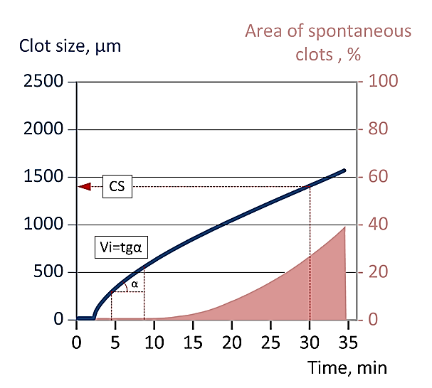
Complementary parameters
13
Vi, [µm/min] – Average rate of clot growth at the time interval 2-6 min of clot growth. V=Vi if spontaneous clotting does not allow normal V calculation
D, [a.u.] – Clot density, intensity of light scattering from a fibrin clot
CS, [µm] – Size of the clot after 30 min of growth
Images
clot size, µm
activator
5 min
15 min
30 min
fibrin clot
spontaneous
clots
plasma
Notes:
There are several complementary parameters. Vi is the average rate of clot growth calculated on the interval 2-6 minutes after the beginning of clot growth, it characterizes the initiation phase of clot growth. If V cannot be calculated because of the presence of spontaneous clots (Tsp is short) V sets equal to Vi parameter .
D is an optical parameter equal to intensity of light scattering from a fibrin clot. It is proportional to the density of the fibrin clot mesh
CS is the clot size on the 30th min of the measurement.

Slide 14
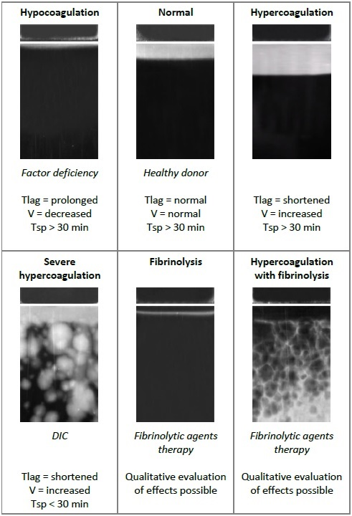
Thrombodynamics results and parameters
14
One of the main features of Thrombodynamics method is the possibility to provide user with the real-time photos of a growing fibrin clot.
These photos can be analyzed qualitatively and quantitatively. The photos themselves can provide information about the state of coagulation system – hypo-, hype-, normal coagulation or fibrinolysis.
The degree of abnormality can be estimated comparing calculated numerical parameters with normal reference ranges (archived in the software).

Slide 15
Thrombodynamics-4D
15
Thrombodynamics-4D additionally measures parameters of spatial dynamics of thrombin generation.
Fibrinogen
Fibrin
Platelets activation
Fibrin clot structure
Fibrinolysis
Endothelium activation

Slide 16
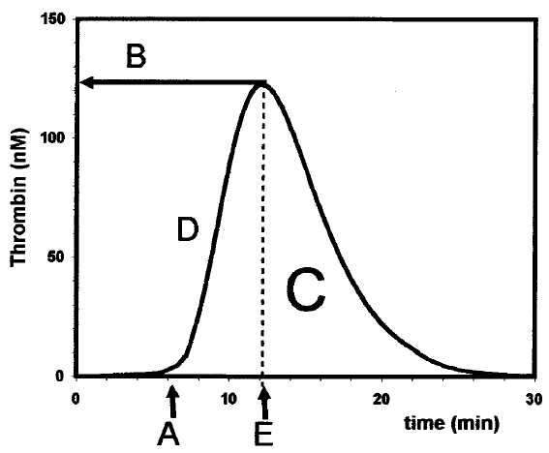
Thrombin generation assays
16
Thrombin Generation Test
Full mixing of a sample with an activator
Thrombodynamics-4D
H.C. Hemker et al, Thromb. Haemost. 2006
?
Local activation
Notes:
A test measuring the activity of thrombin in the case of mixing the sample with an activator has long been developed and exists in a variety of commercially available versions. When activated, the amplitude of thrombin increases dramatically, then thrombin is inhibited. As a result, a characteristic thrombin generation curve is obtained which is characterized by the maximum amplitude, the thrombin generation delay and the area called thrombin potential. And how does generation of thrombin occur in the case when the activator is not in the entire volume, but sits on the wall of the vessel? To answer this question, we developed a new generation of thrombodynamics test, in which it is possible to measure both the formation of fibrin and thrombin

Slide 17
Thrombodynamics-4D measurement
17
TD4D measurement is based on registration of fluorescence signal during cleavage of synthetic AMC-based substrate by thrombin, that reflects kinetics of thrombin generation.
380 nm
440 nm
Thrombin
Substrate
Fluorophore (AMC)

Slide 18
Thrombodynamics-4D measurement
18
Thrombodynamics 4D utilizes methods of fluorescent microscopy to register the spatial dynamics of thrombin generation.
Cuvette
Light source for excitation
(365 nm)
Light source for scattering

Slide 19
ТD-4D vs TD
19
TD4D additionally allows monitoring of spatial dynamics of thrombin generation.
Fibrin clot propagation in (light scattering registration)
Thrombin generation
(fluorescent signal registration)

Slide 20
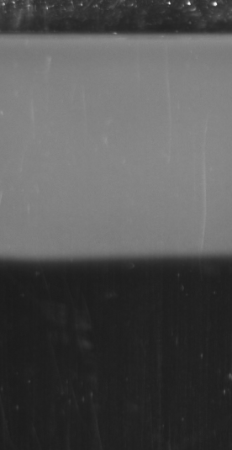
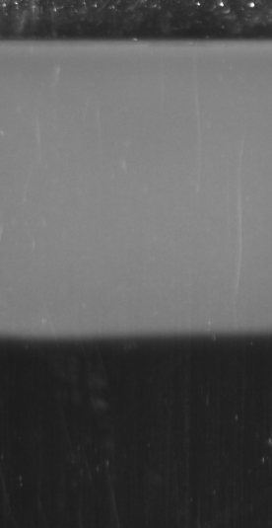
Thrombin propagation during clot growth
20
Fibrin clot growth
min
Thrombin, nM
Distance, mm
Dashkevich et al, Biophys J 2012
Notes:
The upper picture is the activator and the plasma. The formation of fibrin has begun. The graph below shows how the thrombin activity is distributed at this time. A small amount of it appeared on the activator. Next we see a rapid increase in the amount of thrombin, similar to what we saw in the thrombin generation test. The clot has already grown by a notable distance. Further, as the clot grows in the inactivator region, its activity decreases, but we see a spread. As if the peak of thrombin activity is moving, and fibrin moves with it. Removing from the activator, the height of the peak falls, but at some point it becomes stationary, and the growth of the clot is already taking place independently of the tissue factor, since it is already covered by a large layer of fibrin. In this thrombin can be distributed independently.

Slide 21
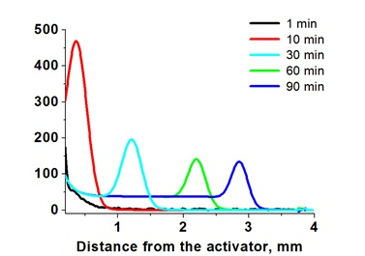
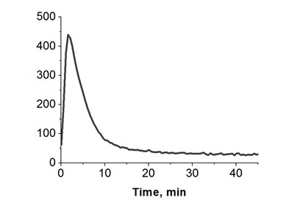
TD-4D main parameters
21
10 min 45 min 90 min
Distance from the activator
Fluorescence images
Spatial thrombin propagation from coagulation activator
Thrombin generation on activating surface (TGT analogue)
Cmax_ATG
Thrombin, AU/L
Thrombin, AU/L
Ast
Tmax_ATG
Main parameters of spatial thrombin generation:
Stationary amplitude of thrombin peak (Ast)
Rate of thrombin peak propagation (Vt)
Main parameters of activator thrombin generation:
Maximum thrombin concentration (Cmax_ATG)
Time to peak (Tmax_ATG)

Slide 22
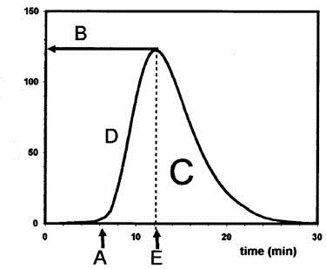
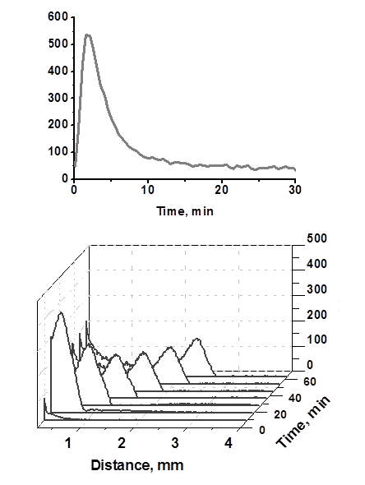
TD4D vs TGT
22
Thrombin Generation Test
H.C. Hemker et al, Thromb. Haemost. 2006
Thrombin, AU/L
Full mixing of a sample with an activator
Thrombodynamics-4D
Thrombin, AU/L
Thrombin, AU/L
Local activation
Notes:
A test measuring the activity of thrombin in the case of mixing the sample with an activator has long been developed and exists in a variety of commercially available versions. When activated, the amplitude of thrombin increases dramatically, then thrombin is inhibited. As a result, a characteristic thrombin generation curve is obtained which is characterized by the maximum amplitude, the thrombin generation delay and the area called thrombin potential. And how does generation of thrombin occur in the case when the activator is not in the entire volume, but sits on the wall of the vessel? To answer this question, we developed a new generation of thrombodynamics test, in which it is possible to measure both the formation of fibrin and thrombin

Slide 23
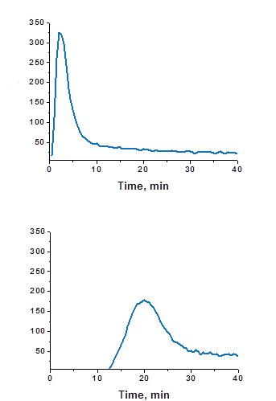
TD-4D vs TGT
23
Thrombin propagation from the activating surface during clot formation leads to sequential rise of thrombin generation peak at a each new point of the sample.
Near activating surface
Thrombin, AU/L
1 mm distance from the activating surface
Thrombin, AU/L
Notes:
In fact, these are not different processes. What is a moving thrombin peak? With the growth of the fibrin clot, successively at each point appears the same peak generation of thrombin, but with a delay in time. And this process of rapid activation and inhibition of thrombin occurs sequentially at all points along the path of clot growth. We see it as a moving peak.

Slide 24
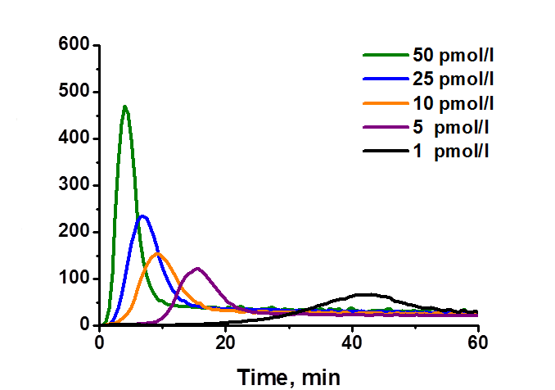
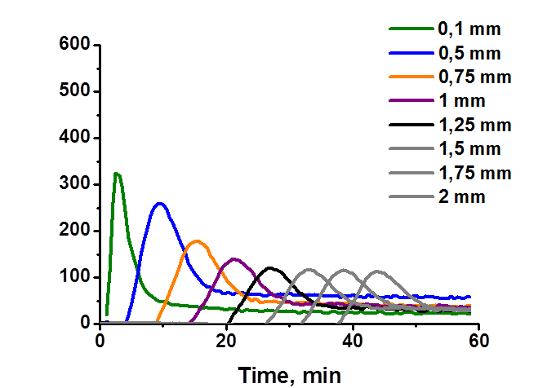
TD-4D vs TGT
24
Measuring thrombin generation in TD4D at a distance of 2 mm from the activating surface is equal to TF concentration weakening down to 1-5 pmol/l.
TF concentration weakening effect
Distance from the activator effect
Thrombin, AU/L
Thrombin, AU/L
This TD4D feature solves problem of poor reproducibility of TGT caused by variations when working with low TF concentrations.
Notes:
One of the difficulties in working with the thrombin generation test is the need to work with low concentrations of activators to achieve maximum sensitivity and not lose sensitivity to reactions of the internal coagulation pathway. This leads to poor reproducibility and a strong dependence on the source of the tissue factor, which requires great accuracy when working with reagents. The left graph shows the thrombin generation curves with different activation powers. The peak decreases, and the delay in the formation of thrombin increases. On the right are the thrombin generation curves when removed from the activator. The maximum amplitude is observed on the activator, then the peak decreases, and everything appears later in time. Those. The same effect of reducing activation is achieved without the use of low concentrations of TF. On the activator it is quite a lot, but when removed from the activator, the peak decreases, and no longer depends on how it was activated. This allows us to circumvent one of the drawbacks of the thrombin generation test when achieving the same effect.

Slide 25
TD-4D features and application – part 1
25
Thrombin – is a major enzyme of coagulation system:
Thrombin is the direct target for new oral anticoagulants (NOAC). TD4D can be used for NOAC effects estimation and therapy control.
Dabigatran - 0 ng/ml
Dabigatran – 150 ng/ml
Example of therapeutic dabigatran dosage influence on spatial dynamics of thrombin generation (mark’s fluorescence signal)

Slide 26
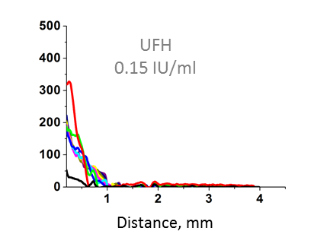
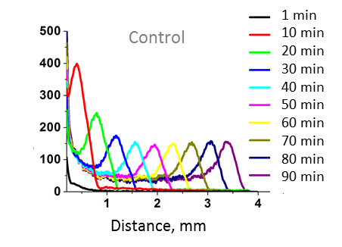
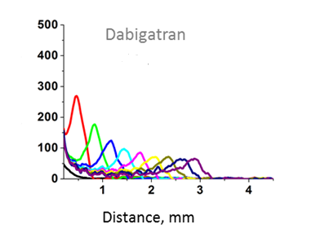
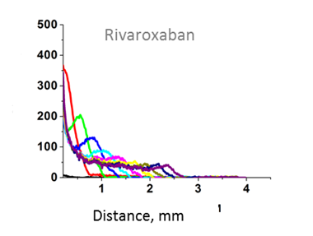
TD-4D possible application:
Effect of NOAC on spatial thrombin generation
26
TD4D is highly sensitive to different types on new direct oral anticoagulants and can be potentially used for therapy monitoring.
Heparin fully inhibited formation of moving peak of thrombin without affecting the initiation time
Thrombin, AU/L
+ UFH
Dabigatran significantly increased initiation time and decreased synchronically the height of thrombin peak on the activator and in space.
200 ng/ml
Thrombin, AU/L
+ Dabigatran
Thrombin, AU/L
+ Rivaroxaban
Rivaroxaban delayed thrombin formation and lead to fast transformation of moving peak to a plateau
130 ng/ml
Thrombin, AU/L

Slide 27
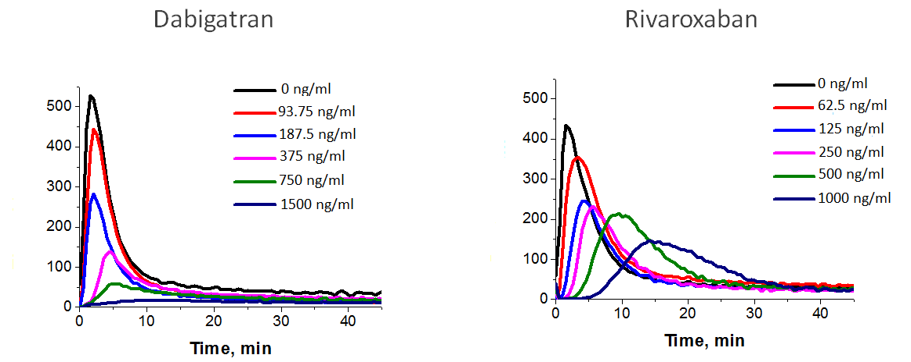
TD-4D possible application:
Effect of NOAC on thrombin generation on the TF-coated surface
27
Thrombin, AU/L
Thrombin, AU/L

Slide 28
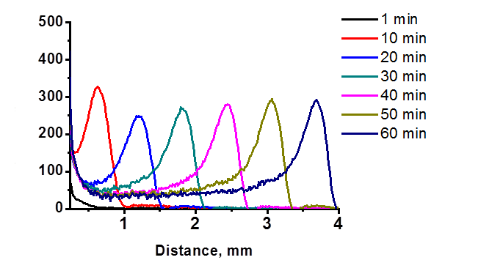
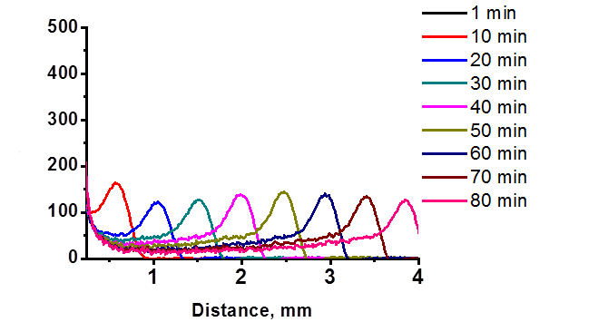
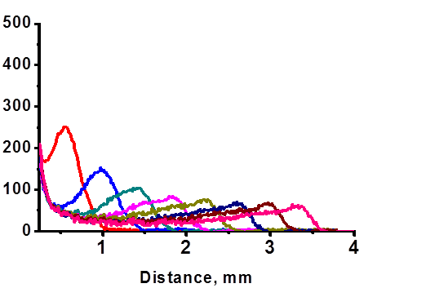
TD-4D possible application:
Effect of NOAC on spatial thrombin generation (ex-vivo)
28
Prophylaxis of VTE after major orthopedic surgery
Patient 1
Thrombin, AU/L
+ 220 mg Dabigatran
Thrombin, AU/L
+ 3 hours
Patient 2
Thrombin, AU/L
+ 10 mg Rivaroxaban
Thrombin, AU/L
+ 2 hours

Slide 29
TD-4D possible application:
Effect of platelets concentration and functionality
29
TD-4D is sensitive to platelets concentration, PS expression and alpha-granules release
+ADP 100 µM
Thrombin, AU/L
Thrombin, AU/L
Thrombin, AU/L

Slide 30
New TD-4D test features – part 2
30
Thrombin generation depends on functional activity of platelets. TD4D can be used for antiplatelet therapy control.
Preliminary in-vitro data:
TD4D is sensitive to inhibitors of the P2Y12 receptor (antiplatelet drugs like ticagrelor and clopidogrel (Plavix)).
Effect of P2Y12 receptor inhibitor on rate of thrombin peak propagation

Slide 31
Thrombodynamics Software
31
Detailed measurement results view
Design and ergonomics – ErgoSign, Germany
Real-time pictures of growing clot
Results saved to database with extensive search options
Customizable user preferences and access rights
Online software update
Measurement progress

Slide 32
Thrombodynamics-4D assay report
32

Slide 33
Thrombodynamics-4D
33
Thrombodynamics-4D =
Thrombodynamics +
Thrombin Generation Test
All thrombodynamics features: reveals both hypo- and hypercoagulation states, highest sensitivity to all classic anticoagulants (heparins, warfarin);
Possibility to evaluate effects of new oral direct anticoagulants;
Possibility to evaluate platelets procoagulant function;
Available in EU for research use only

Slide 34
For further Questions, please contact

